Slide 1


Robrix
A multi-platform Rust app
for Matrix chat and more
Kevin Boos Principal Architect, Futurewei May 6th, 2024

Slide 2
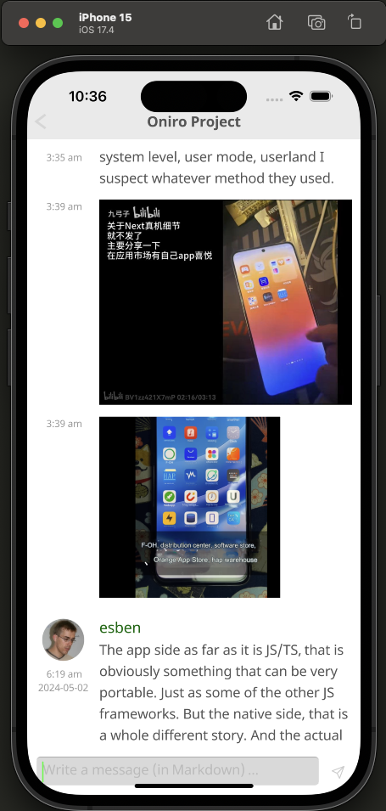
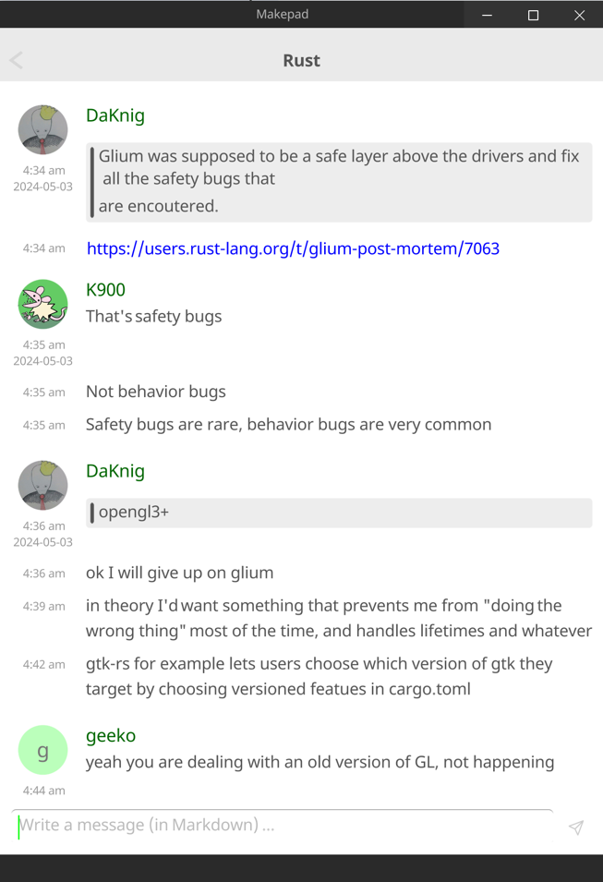
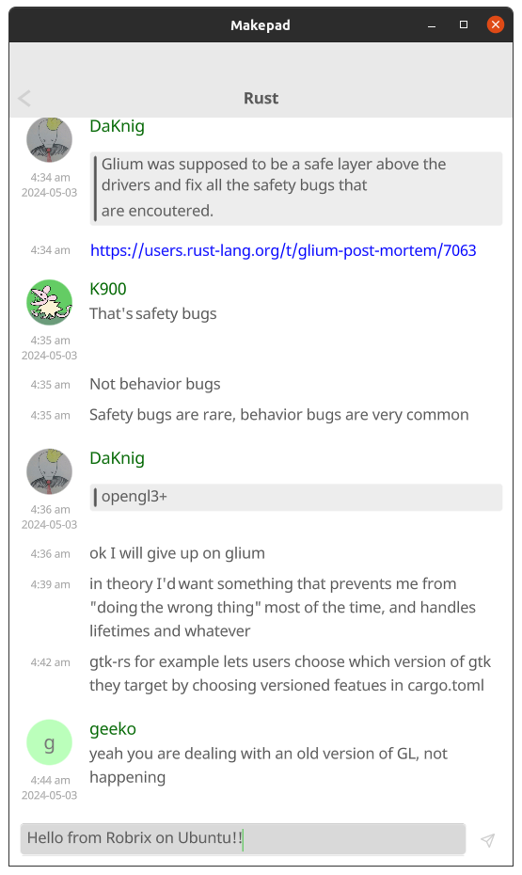
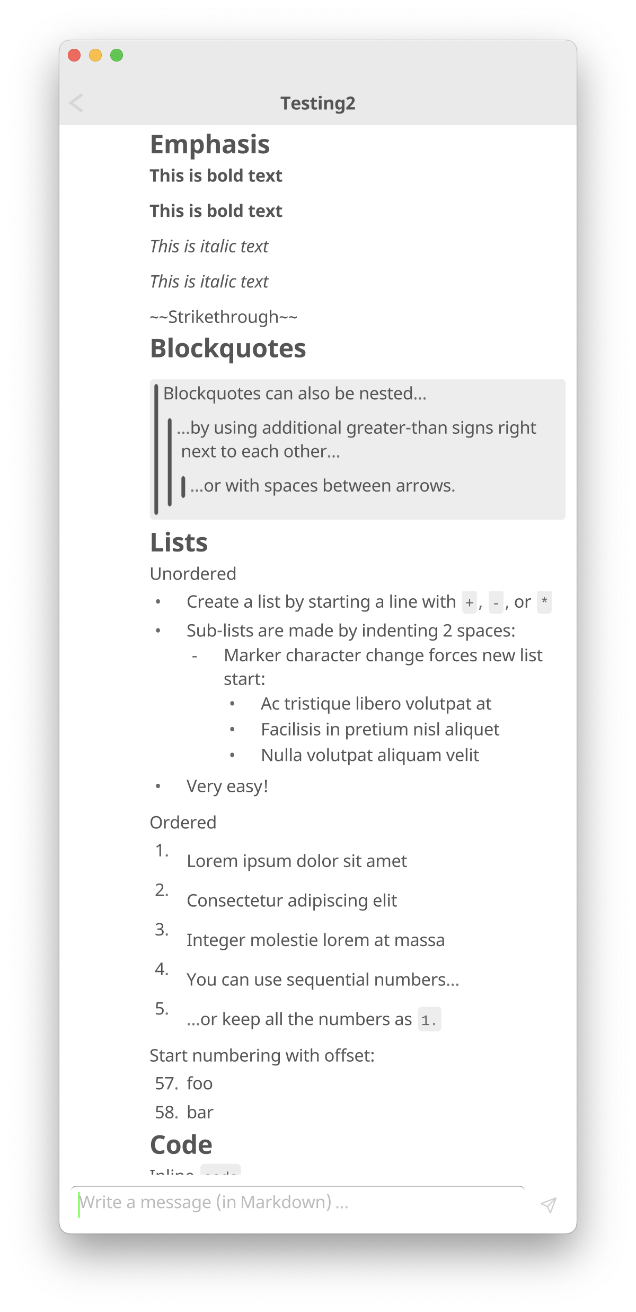

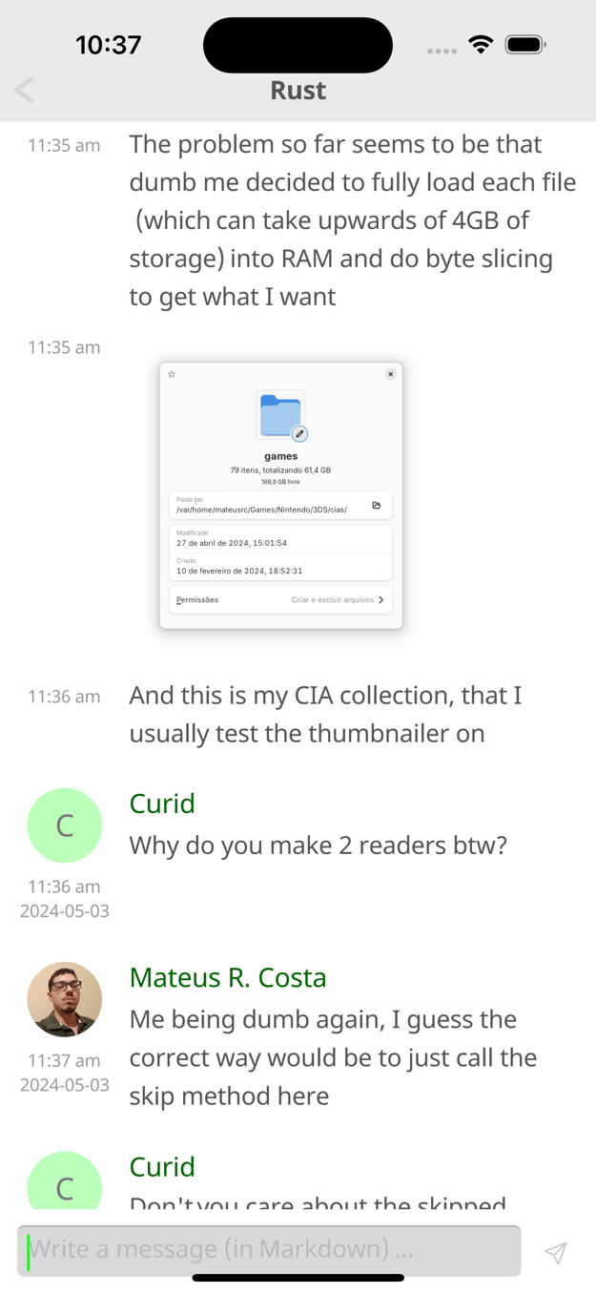
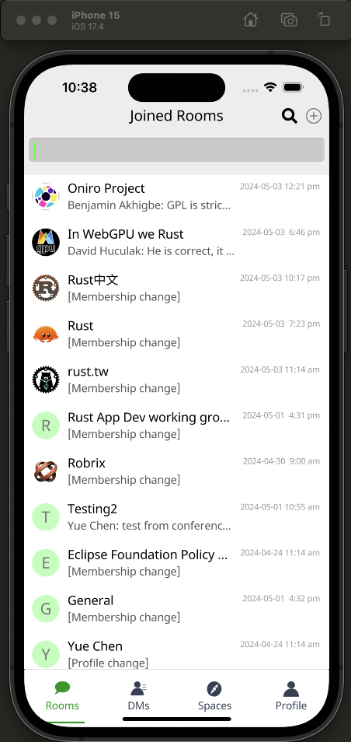
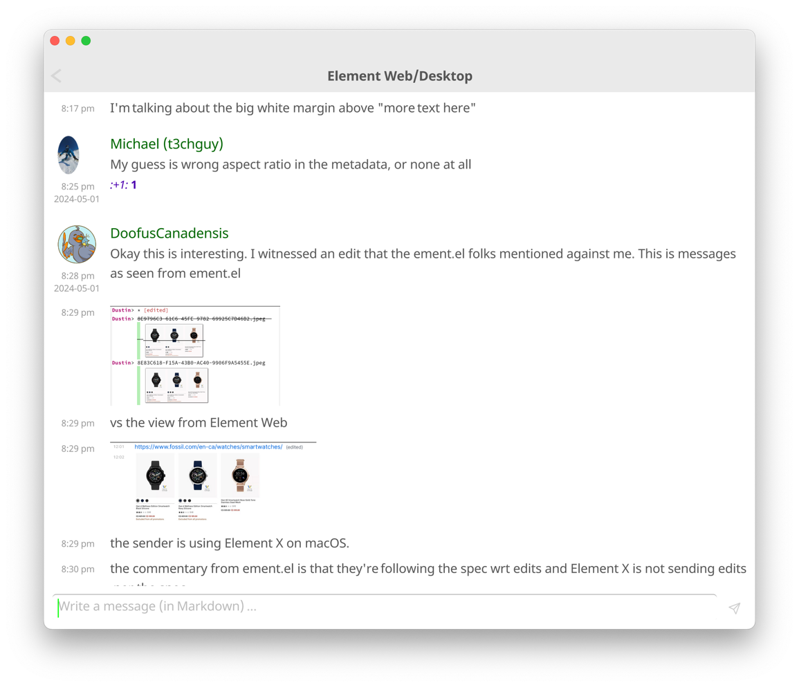
Robrix
One code base, many platforms

Slide 3
Motivation

Slide 4



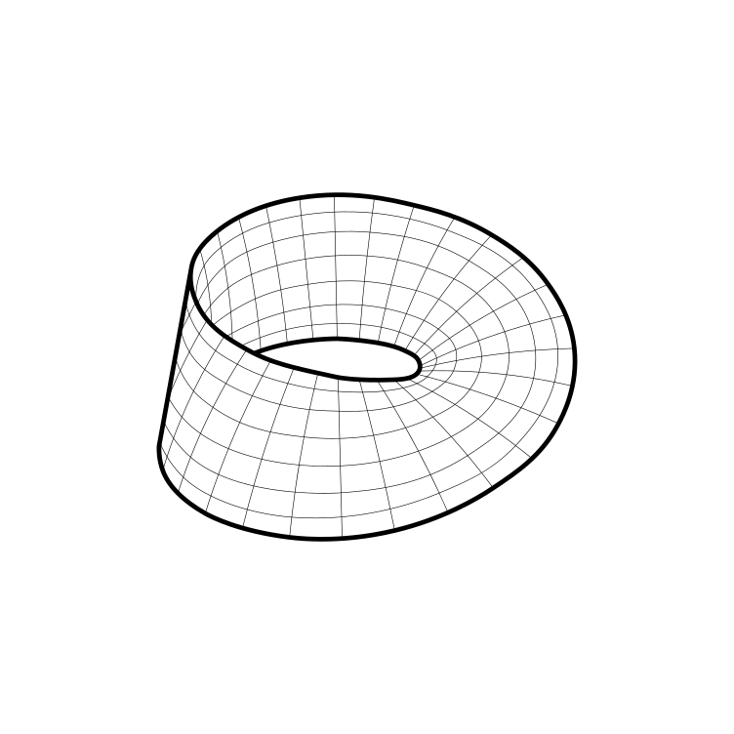
Project Robius at a glance
Create a multi-platform app dev experience fully in Rust
leverage the robust, safe, and performant Rust ecosystem
avoid dealing with multiple languages/environments
never write a single line of platform-specific code
Make Mobile a first-class concern in the Rust community
The Rust experience on Mobile feels neglected
Devs can:
Notes:
Robius strives to do to two main things

Slide 5
Background — Project Robius app dev framework
Fully open-source, decentralized, and community-driven
Independent collaborators across US, Europe, Aus/NZ, S. America, China
All components written entirely in Rust
But why Robius? … there are tons of great Rust UI toolkits out there
egui, Iced, Slint, Leptos, Tauri, Dioxus, Makepad, Xilem, Freya, Ribir, …
→ There’s way more to app dev than just drawing a GUI!
Many existing Rust apps are “less Rust, more other code”
A small Rust core surrounded by big platform-specific wrappers
Notes:
There are quite a few projects that experiment with how to build a great GUI using Rust; Dioxus, tauri, makepad, Xilem and the linebender project, etc. But to build a fully-featured app these days, you need an awful lot more than just UI and basic input events. That's what Project Robius is all about: we leave UI design to the experts, and step in to fill the gaps everywhere else in the app dev environment. This includes everything from complex build systems, support for platform-specific APIs and OS services (with nice Rust abstractions for each class of functionality), signing/packaging/bundling/distributing apps, and more. Everything is entirely open-source and decentralized. Nothing is owned or controlled by one party, and we welcome contributions from anyone and everyone.

Slide 6
Why Robrix, though?
Needed a key app to drive development of Robius components
“What kind of app requires lots of platform functionality?” → Matrix!
Network, geo-location, file/image access, audio/video capture & playback, system notifications, clipboard, rich text formatting & input, local storage/caching, connectivity mgmt., biometric authentication, secret storage
After that … why not take it further?
Make Robrix a central “hub” for using federated services
Focus on the needs of the open-source developer community
Matrix, ActivityPub, local AI LLMs, source code (re)view, etc.
Notes:
There are quite a few projects that experiment with how to build a great GUI using Rust; Dioxus, tauri, makepad, Xilem and the linebender project, etc. But to build a fully-featured app these days, you need an awful lot more than just UI and basic input events. That's what Project Robius is all about: we leave UI design to the experts, and step in to fill the gaps everywhere else in the app dev environment. This includes everything from complex build systems, support for platform-specific APIs and OS services (with nice Rust abstractions for each class of functionality), signing/packaging/bundling/distributing apps, and more. Everything is entirely open-source and decentralized. Nothing is owned or controlled by one party, and we welcome contributions from anyone and everyone.

Slide 7
for more on Project Robius, check out my RustNL talk, Wednesday @ 10am
7

Slide 8
Goals & Roadmap (selected)
Notes:
Project Robius has quite a few goals and technical requirements, which you can read about in full on our website or github page.
For now, in the interest of time, I’m going to just discuss a select few.

Slide 9

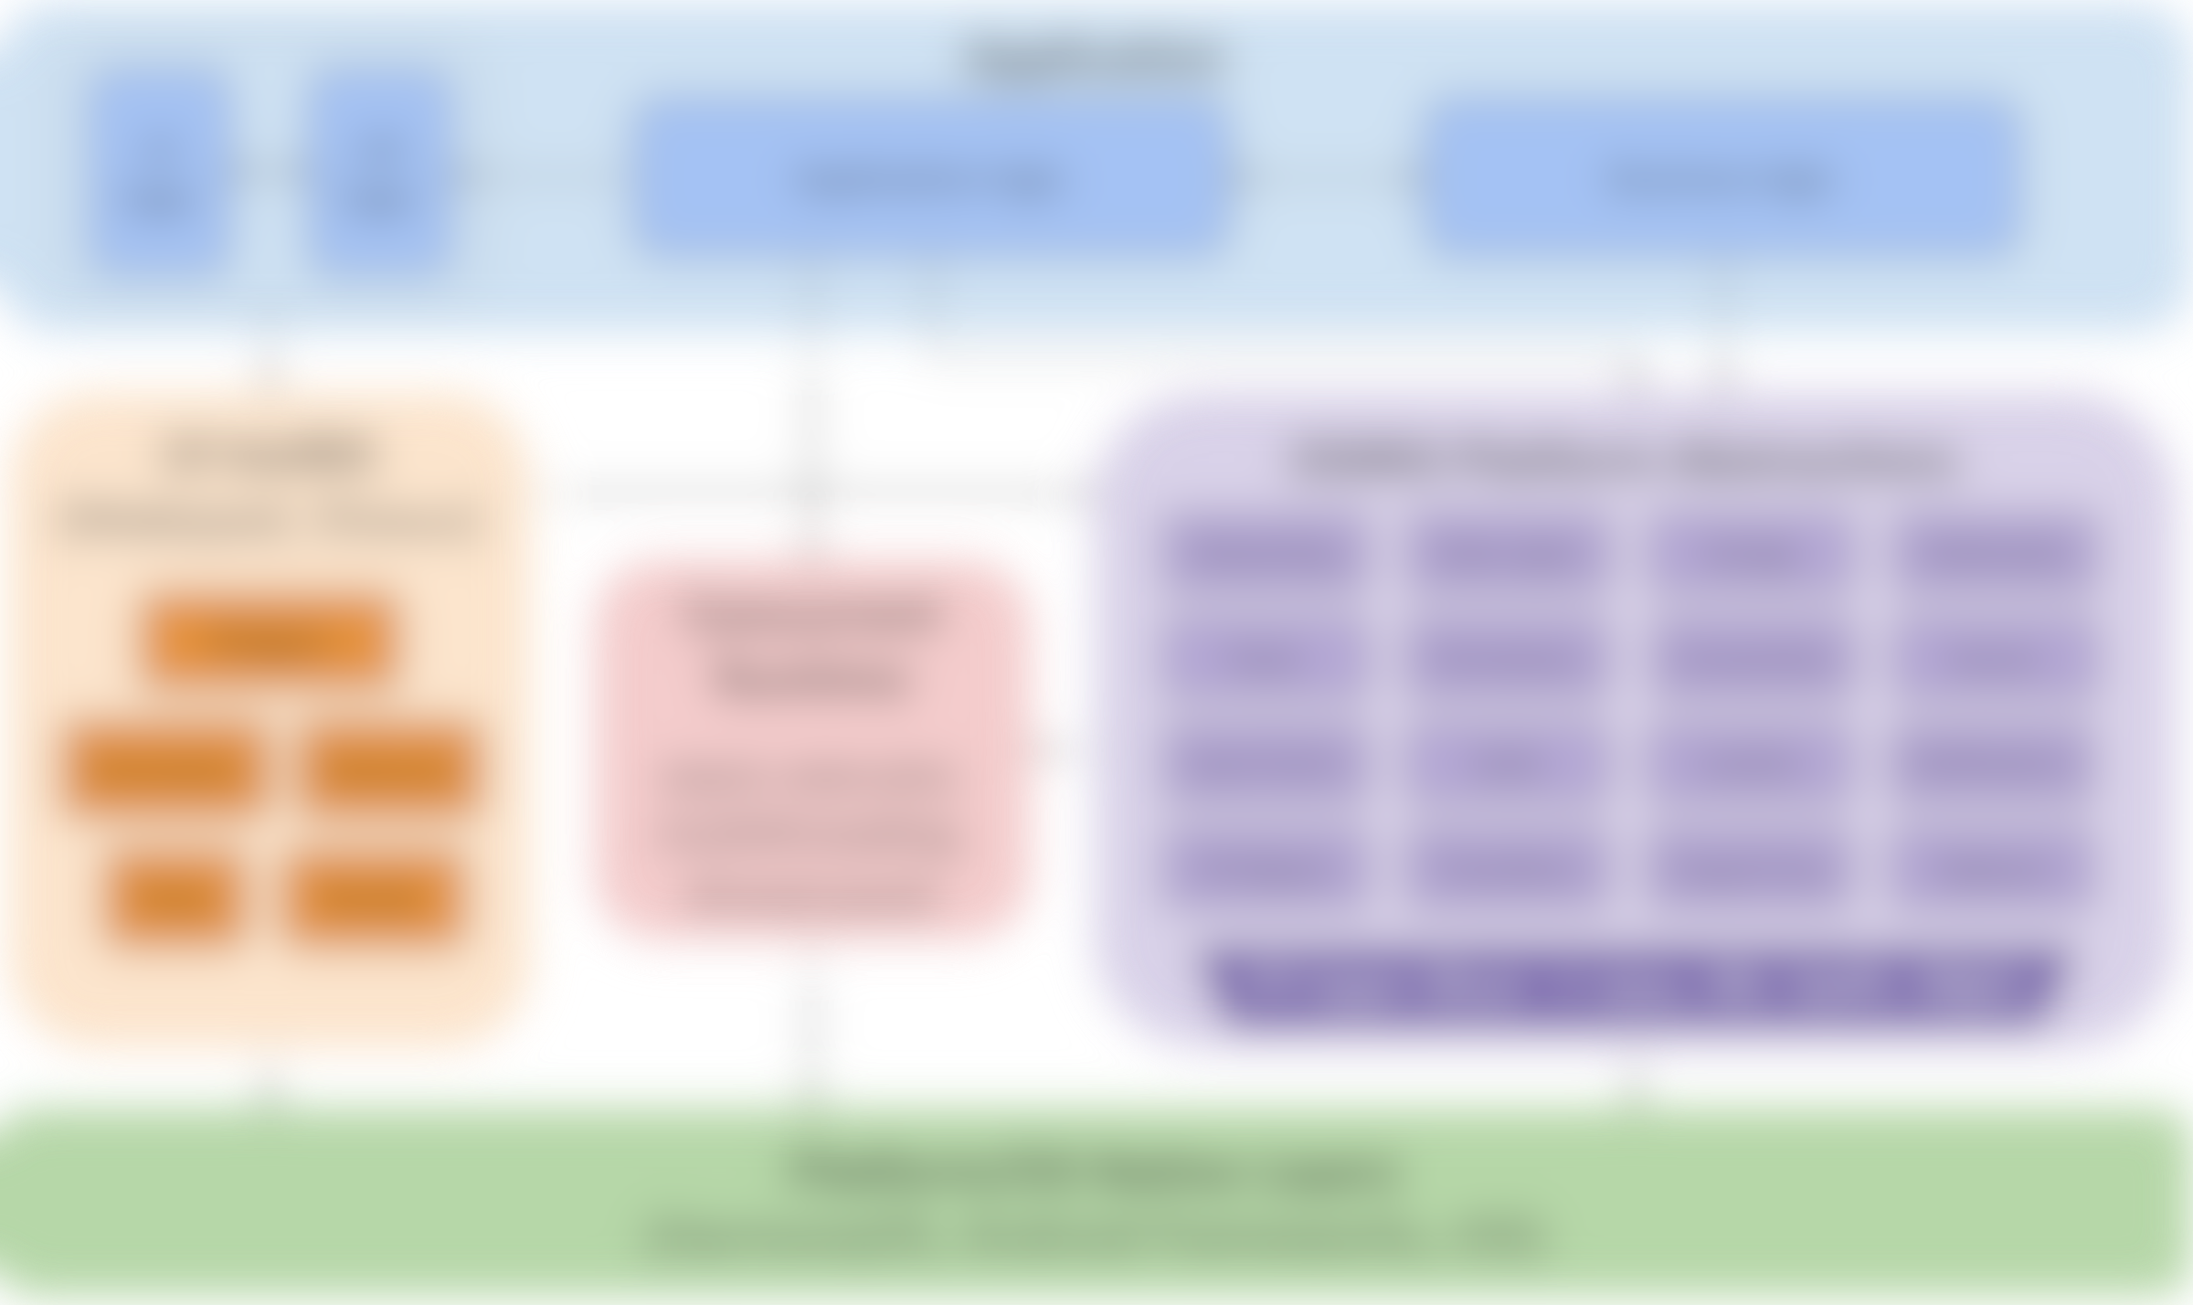
Create reference design of full Robius system stack
Application
UI logic
UX logic
Application logic
Business logic
runtime components
UI toolkit (Makepad, Dioxus)
Platform Abstractions
Networking
State mgmt
Storage
Multimedia
Widgets
Concurrency Manager
async executor, main & bkgd thread mgmt
Power
Permissions
Connectivity
Sensors
Animation
Gestures
Input Events
Audio
Location
Notifications
Events
Drawing
IPC/Signals
Time/Alarm
Drag & Drop
Clipboard
FFI layer (Rust → native language)
Platform/OS Native Layers (Linux, macOS, Windows, Android, iOS, Web, HarmonyOS …)
details coming later…
Notes:
Our primary goal is to establish a complete, working example of everything beneath the app
Which must support major platforms/OS environments
UI toolkits – Makepad, Dioxus, Slint
Offers a variety of UI development options and styles
Generally cross-platform, with a focus on GUI design and workloads
OSIRIS - OS Interfaces in Rust
Rust abstractions of platform and OS-specific functionality
Focus on non-GUI subsystems
Standard subsystems: networking, storage, audio, time
UI-adjacent services: notifications, clipboard, drag & drop
Mobile-oriented:
Sensors/actuator: accelerometer/gyro, ambient light, pressure, temp, vibration, location, buttons, LEDs, biometrics
Multimedia: camera, mic, speaker
Touch screen, display brightness
Connectivity: WiFi discovery, bluetooth, NFC, USB, phone modem
Power: battery, charging, idle/standby/awake status
Permissions management: declaring, requesting, revoking
Goal: easy to integrate OSIRIS into a UI app as a dependency
Low-/zero-cost abstractions, as close to native as possible
Future: high-level, off-system mobile services
RESTful APIs: mapping, authentication, Google Play services, etc
Can likely use or start from the foundation of Open Mobile Hub
Concurrent / parallel computation runtime
Async execution runtime – ylong, tokio, async-std (smol)
Threads, thread pools, and CPU/multicore abstractions

Slide 10
Application
Application
UI / UX
Convos/ rooms list
Chat view
Room browser
Application logic
Business logic (SDK)
Persistent settings
Push notifs.
Local msg database
Online status
File sync
Join/ leave room
Matrix message send/recv
read status
Settings, Themes
In-app notifs.
Context for chat/msg
Robrix App Architecture
(Matrix client only)
Robrix’s needs guide Robius development and implementation priority
Image viewer
Create or delete chat
Quick replies
Access camera, mic, speaker
Multi-device login mgmt
Account management
Contacts
Video display
File/media chooser
Search
Rich text fmt
Multimedia streaming, calling
Reactions
Local media storage
Authentication
Thread view
Reply linking
UI toolkit (Makepad, Dioxus)
Platform Abstractions
Concurrency Manager
Concurrent Runtime
async executor, multithreading, thread pools
Networking
State mgmt
Storage/Cache
Multimedia
Widgets
async executor
CPU affinity
Input Events
Audio
Connectivity
Notifications
Animation
Gestures
Authentication
Permissions
Drag & Drop
Clipboard
Events
Render
main/bkgd threading
FFI layer (Rust → native language)
Platform/OS Native Layers
Notes:
We will lead the development of this app to help drive the design of OSIRIS and prioritize which service abstractions we implement first.
We expect this application to consist of quite a few entities spread across the application, both for app logic and business logic,
as well as significant UI and UX components that will serve as valuable stress tests for the UI toolkits, which are still in active development.
One good thing about this choice of application category is that there are several existing examples,
which we can use as a basis of comparison to help evaluate key aspects of Robius like overall performance, ease of development, and more.
Those applications include:
Element, the first-party Matrix chat, and their newer apps Element-X that I previously mentioned,
Fluffychat, a Matrix chat client written in Flutter,
Quadrix
Cinny
Schildi Chat

Slide 11
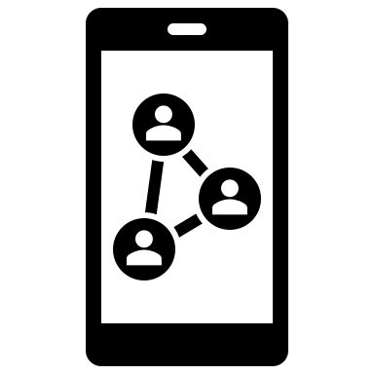




Meta-goals for Robrix as a flagship Robius app
Well-structured, well-commented code
Easy to fork and modify
Easy to contribute features back to upstream
Publish detailed walkthrough that guides a dev through how to make a (simplified) Robius app
Exemplify the utility & power of Robius framework
Demonstrate how nice & flexible Makepad apps can be

Slide 12



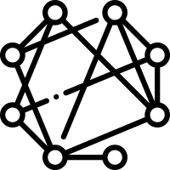
Roadmap
Stage 1: publish app with fundamental Matrix client features
Standard messaging, login, app persistence, E2EE support
Continue building full App Dev ecosystem and UI toolkit
Stage 2: Matrix client for “power” users
Feature parity with existing major clients (incl. administrative features)
Responsive UI design with side-by-side multi-room view
Local LLM runtime for AI chat bots & conversation summaries
Key point: does not jeopardize E2EE or data sovereignty
Stage 3: central “hub” for federated & open-source services
Collect multiple services: chat, discussion forums, code + issues + PRs, announcements/microblogs, feed of notifications/activity/news
Identity management via integration with Open Wallet Foundation
Notes:
Stage 1: [now] Robrix as a simple Matrix client
Try to reach fundamental featureset to prove Robius works
(whilst building the entire UI & App Dev ecosystem)
Structure of Robrix
Arch diagram of Robius, then Arch diagram of Robrix
Then actual block diagram of software components in Robrix
e.g., UI main thread, using Makepad components, using background threads, tokio for async, matrix rust SDK, the app talking to robius components off to the side, which talk directly to the platform
Demo of Robrix
Stage 2: [within 1 year] Robrix as a power-user Matrix client
Approx feature parity with existing clients
Plus more: side-by-side-by-side layout of horizontal panes (desktop, tablet, foldable)
Visually beautiful and customizable
Fast nav, keyboard-driven interaction mode
Integration of local LLMs for many benefits without jeopardizing E2EE or data sovereignty:
AI-assisted chat synopses, topic analysis, “what you missed”, etc
Automatic public chat-bot response channels to help newcomers to large open-source communities
Stage 3: [1+ year out] Robrix as a central hub for federated services
Introduce our vision for other services: ActivityPub, mastodon, lemmy, code/reviews (github)
All the stuff the open-source community wants, all in one place
Singular idenity management & support via integration with Open Wallet Foundation

Slide 13
Stage 1: Robrix chat

Slide 14
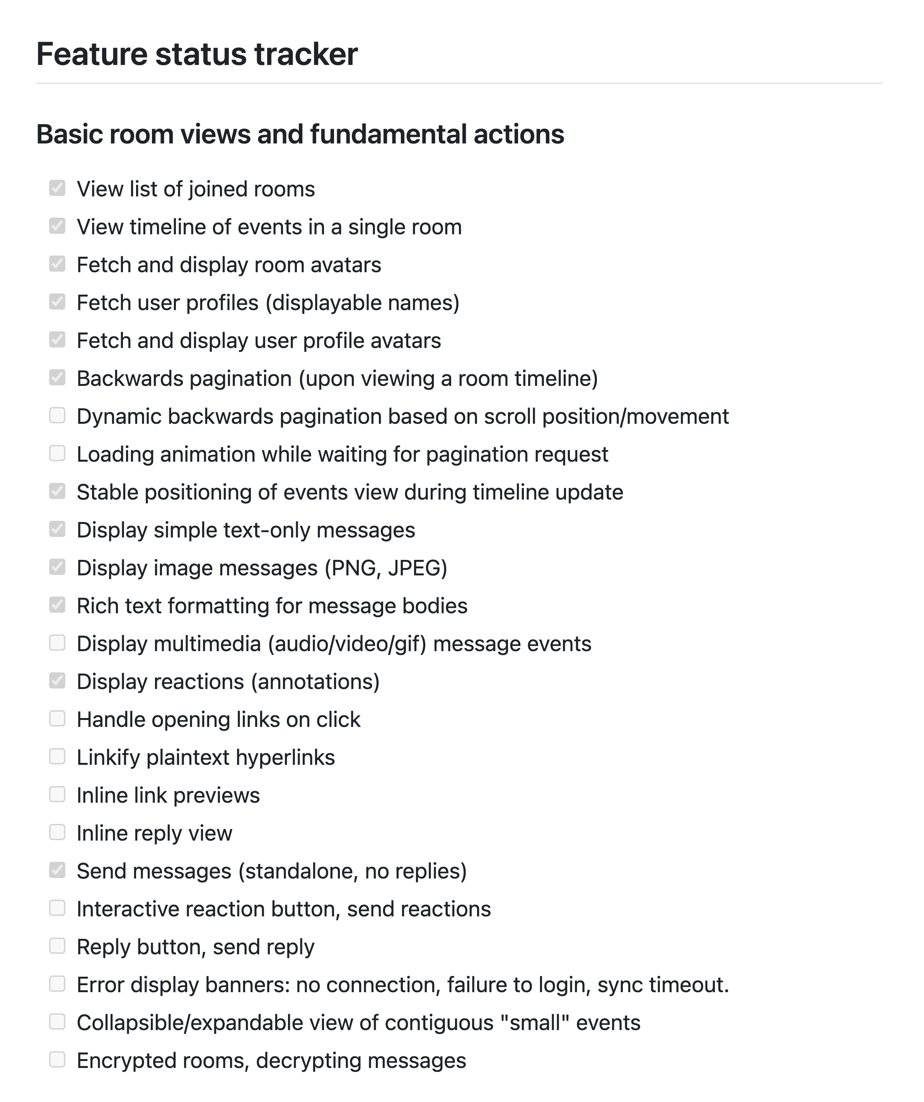
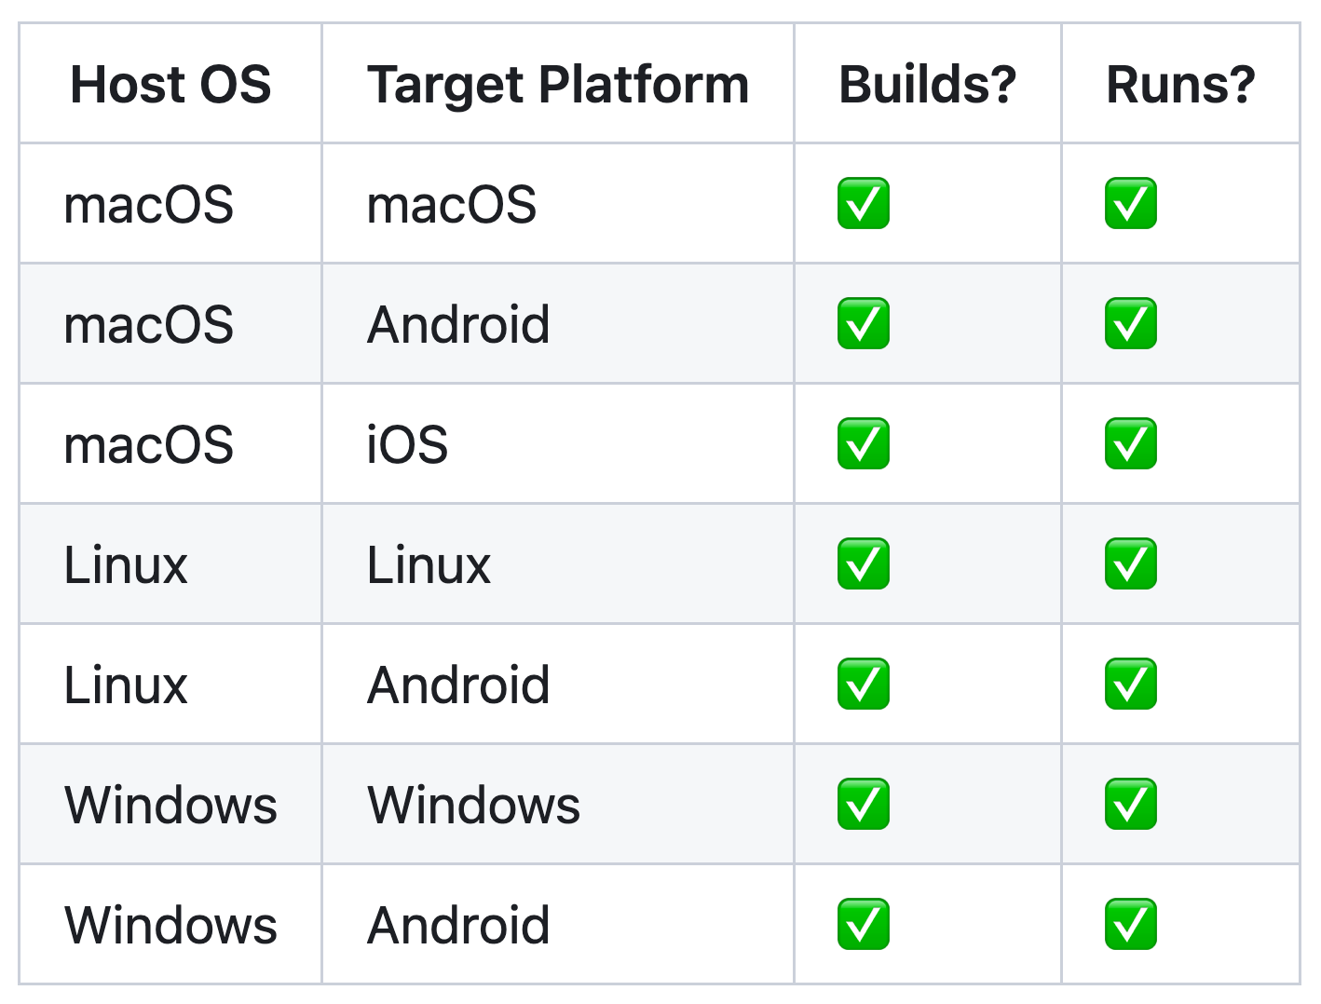
Stage 1: the basics
github.com/project-robius/robrix
Realize simple Matrix client
Login, rooms list (sliding sync), basic messaging, annotations, replies, rich text formatting, images, E2EE support, app persistence
Publish Robrix to app stores
Requires developing build tooling for releasing, signing, packaging
Complete platform support
Notes:
Finish Robrix app Stage 1: realizing fundamental Matrix client features.
Fundamental features include those required for basic use: login flow, persistent state, secret storage, E2EE support, inline replies, room search, message content search.
Excludes administrative features; those are part of Stage 2 below.
Publish Robrix to crates.io, Google Play store, and macOS app store.
Begin work to publish Robrix on iOS and Linux package managers.

Slide 15
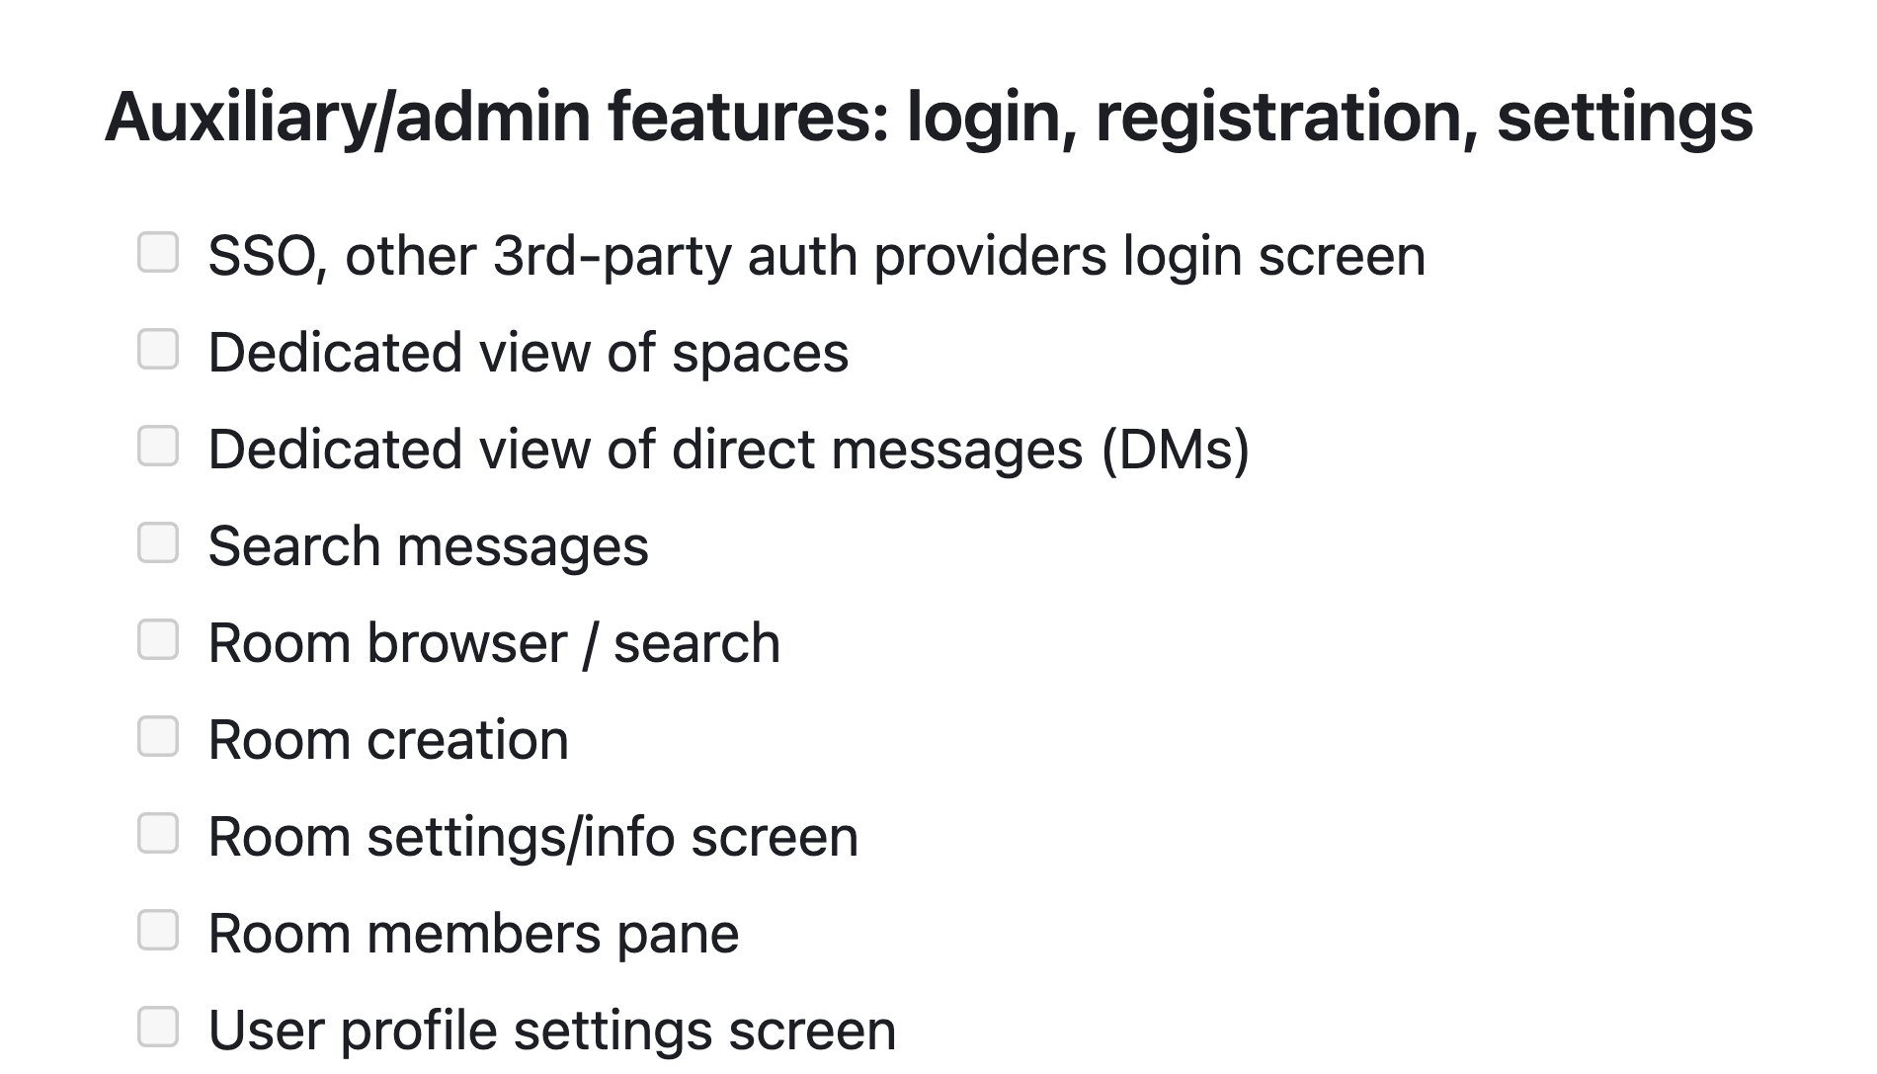
Some basics to save for Stage 2 (later 2024)
Features that don’t drive Project Robius development

Slide 16
Significant implementation challenges
Exposing & abstracting platform APIs / OS services
Handling complex multi-step builds
Rust compilation: invoking & configuring Cargo
Standardizing compilation of non-Rust system glue layers
Supporting platform-specific toolchains and linking conventions
Defining and executing pre- and post-compilation steps
Signing, bundling, packaging, distributing apps
Required for displaying notifications (and so much more)
Managing concurrency: multi-threading, async/sync, hetero CPUs…
UI & other select workloads must run on “main” thread
Certain APIs require async, others forbid async
Contending with multiple vastly different UI toolkits
Platform support crates must be easy to integrate with UI system internals
all across
disparate
platforms
Notes:
Permissions handling
Collecting and merging permissions from app, UI toolkit, dependencies

Slide 17
Targeted platform abstractions / OS service APIs
System notifications
Biometrics & authentication
File/image picker dialogs
Context menus (OS-native)
Menu bar (desktop only)
Rich clipboard
Drag & Drop
Default URI/Intent handling
Content sharing to foreign app
Native font access
Input Method Editors (IME)
Native gesture recognition
Connectivity management
WiFi, Bluetooth, NFC, nearby devices
GPS/Location access
Multimedia capture
Device discovery & configuration
Camera – snapshots, video, settings
Audio – input, MIDI, playback
Sensors
Native alarms, timers
Keychain (secret storage)
Power management/status
App lifecycle state transitions
and so much more …

Slide 18
Status — just getting started, lots to do!
System notifications
Biometrics & authentication
File/image picker dialogs
Context menus (OS-native)
Menu bar (desktop only)
Rich clipboard
Drag & Drop
Default URI/Intent handling
Content sharing to foreign app
Native font access
Input Method Editors (IME)
Native gesture recognition
Connectivity management
WiFi, Bluetooth, NFC, nearby devices
GPS/Location access
Multimedia capture
Device discovery & configuration
Camera – snapshots, video, settings
Audio – input, MIDI, playback
Sensors
Native alarms, timers
Keychain (secret storage)
Power management/status
App lifecycle state transitions
and so much more …
Notes:
Most of these, but not all, are useful within Robrix but not technically mandatory.
Approximate proposed order:
Biometrics/authentication
Open URI / share object to another app (Intents, “sharesheet”)
Geolocation
System notifications
Native file/image picker dialog
Native font access (fallback for UI-packaged font stack)
Registration as default app (Intent handler)
Native rich clipboard access with full-MIME types
Native context menus

Slide 19
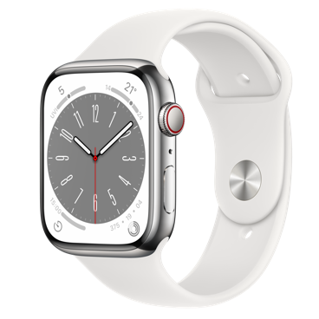








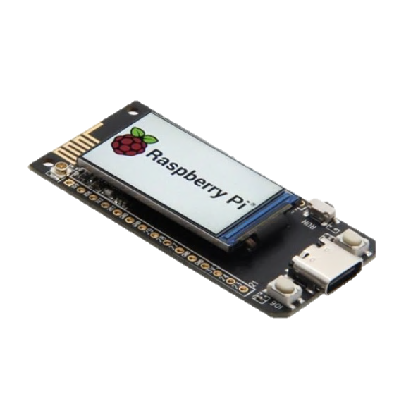
Platforms of interest
Desktop
macOS
Linux (primarily Debian-based)
Windows
Mobile
Android
iOS
[Future] OpenHarmony OS
Web, wasm
Others?
Select microcontrollers/peripherals
tvOS, watchOS

Slide 20
Demo time!

Slide 21
<demo> for future/offline viewers: the demo included an overview of Robrix running on macOS and Android. Check out our git repo and run it on your own machine here: https://github.com/project-robius/robrix
21
Notes:
go over structure of components we’ve designed
Custom HTML parser & renderer
Extremely lightweight, no web engine, no CSS
Custom caching layer for drawing & populating UI widgets
Able to integrate with fine-grained events from Matrix SDK

Slide 22
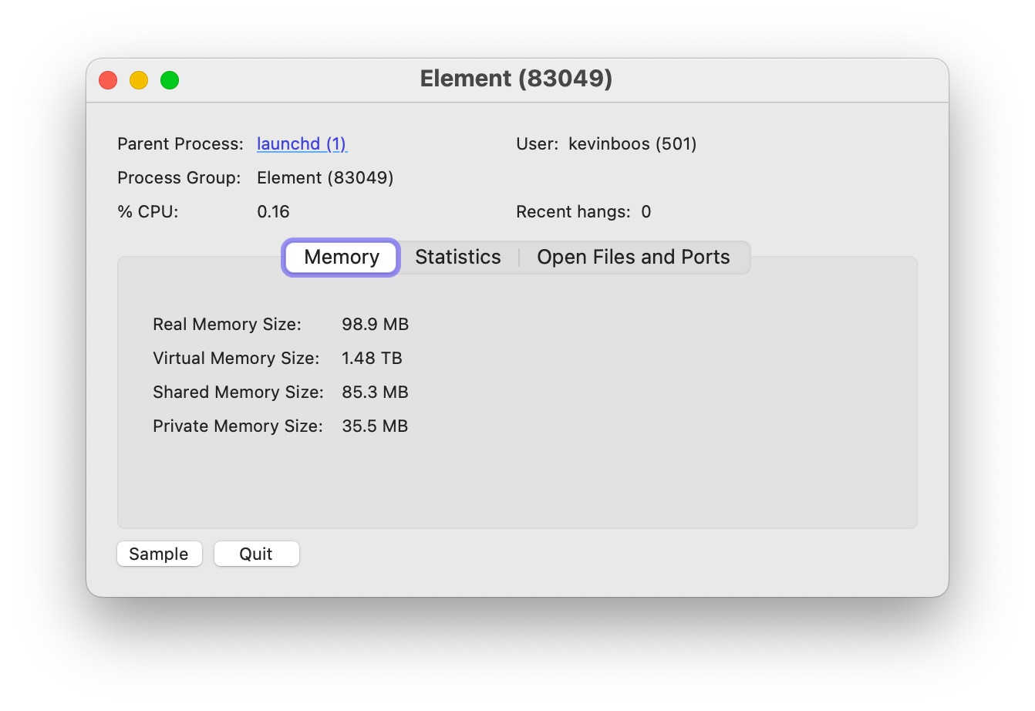



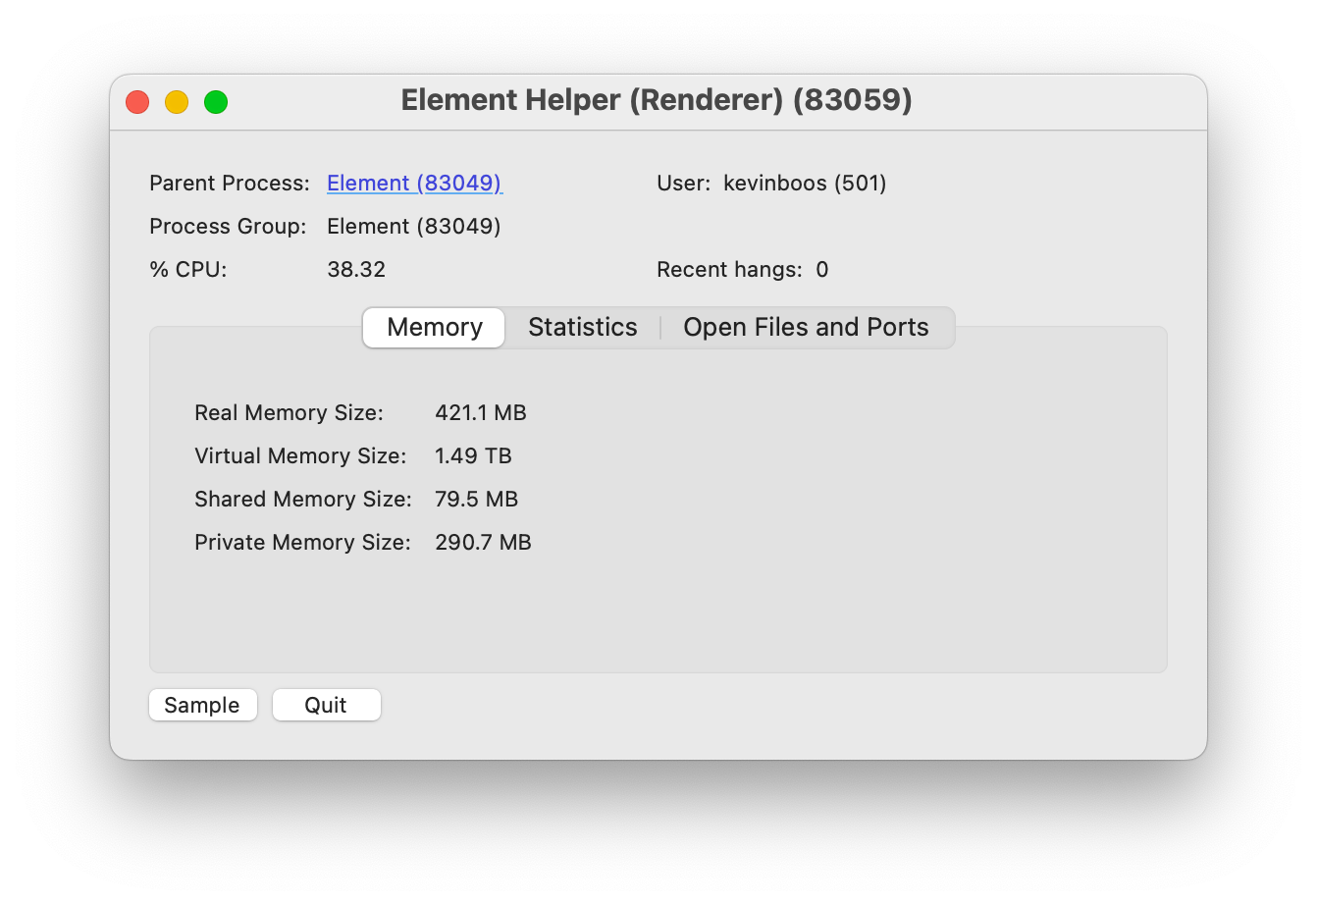
Makepad + Robius stack is efficient
30% fonts
32% framebuffers
→ Related benchmarks for Makepad:
robius.rs/blog/performance-benchmarking-2/
Notes:
Plus a sub-10 sec compile time from a clean build

Slide 23
(brief) Systems Challenges

Slide 24
Robrix development revealed a concurrency challenge
impl Widget for TimelineView {
fn draw_walk(&mut self, cx: &mut Cx2d, scope: &mut Scope, walk: Walk) -> DrawStep {
while let Some(item_id) = self.list.next_visible_item(cx) {
let Some(timeline_item) = self.tl_items.get(tl_idx) else { ... }; if let TimelineItemKind::Event(event_tl_item) = match timeline_item.kind() {
if let TimelineItemContent::Message(message) = event_tl_item.content() {
if let MessageType::Image(image) = message.msgtype() {
let (item, existed) = list.item (cx, item_id, live_id!(ImageMessage))?;
let Some(mimetype, width, height) = image.info.as_ref() else { return }; let text_or_image_widget = item.text_or_image(id!(content.message));
let media_request = MediaRequest { source: image.source, format: ... };
let data = matrix_client.media().get_media_content(&media_request, true).await?;
text_or_image_widget.show_image(|img| utils::load_png_or_jpg(&img, cx, &data));
...
}
}
}
}
}
}
A typical first attempt to fetch and draw an image
error[E0728]: `await` is only allowed inside `async` functions and blocks
|
1048 | fn draw_walk(
| ------------- this is not `async`
...
1132 | let data = matrix_client.media().get_media_content(&media_request, true).await?;
only allowed inside `async` functions and blocks ^^^^^
Notes:
Insert slide of some simplified code that shows two problems when failing to properly deal with mixed (forms of) concurrency
Invoking a blocking function from the main UI thread will hang the UI
Even if the function is async, it could still be blocked while the async executor is running during its timeslice
Key point: don’t try to run async functions (spawn async tasks) on the main UI thread
Trying to invoke an async function directly from the main thread
Also happens if you did it from a regular background thread

Slide 25
Robrix development revealed a concurrency challenge
impl Widget for TimelineView {
fn draw_walk(&mut self, cx: &mut Cx2d, scope: &mut Scope, walk: Walk) -> DrawStep {
while let Some(item_id) = self.list.next_visible_item(cx) {
let Some(timeline_item) = self.tl_items.get(tl_idx) else { ... }; if let TimelineItemKind::Event(event_tl_item) = match timeline_item.kind() {
if let TimelineItemContent::Message(message) = event_tl_item.content() {
if let MessageType::Image(image) = message.msgtype() {
let (item, existed) = list.item (cx, item_id, live_id!(ImageMessage))?;
let Some(mimetype, width, height) = image.info.as_ref() else { return }; let text_or_image_widget = item.text_or_image(id!(content.message));
let media_request = MediaRequest { source: image.source, format: ... };
let data = Handle::current().spawn(async {
matrix_client.media().get_media_content(&media_request, true).await?
});
text_or_image_widget.show_image(|img| utils::load_png_or_jpg(&img, cx, &data));
...
} } } } } }
Ok, let’s try the request in a spawned async task
thread 'main' panicked at src/home/room_screen.rs:1128:25:
there is no reactor running, must be called from the context of a Tokio 1.x runtime
Notes:
Insert slide of some simplified code that shows two problems when failing to properly deal with mixed (forms of) concurrency
Invoking a blocking function from the main UI thread will hang the UI
Even if the function is async, it could still be blocked while the async executor is running during its timeslice
Key point: don’t try to run async functions (spawn async tasks) on the main UI thread
Trying to invoke an async function directly from the main thread
Also happens if you did it from a regular background thread

Slide 26
Robrix development revealed a concurrency challenge
Obvious: must not block the main UI thread
Invoking a blocking (sync) function from the main thread will hang the UI
Especially if it causes a syscall, where the OS may put the thread to sleep
Less obvious: async functions can also block the main thread
Even if the function is async, that native thread could still be blocked while the async executor is polling the future being awaited
Same issue can occur on background threads, too (but that’s ok)
Key point:
→ Don’t invoke any blocking functions, even “non-blocking” async (on the main UI thread)

Slide 27
Robrix development revealed a concurrency challenge
impl Widget for TimelineView {
fn draw_walk(&mut self, cx: &mut Cx2d, scope: &mut Scope, walk: Walk) -> DrawStep {
while let Some(item_id) = self.list.next_visible_item(cx) {
let Some(timeline_item) = self.tl_items.get(tl_idx) else { ... }; if let TimelineItemKind::Event(event_tl_item) = match timeline_item.kind() {
if let TimelineItemContent::Message(message) = event_tl_item.content() {
if let MessageType::Image(image) = message.msgtype() {
let (item, existed) = list.item (cx, item_id, live_id!(ImageMessage)).unwrap();
let Some(mimetype, width, height) = image.info.as_ref() else { return }; let text_or_image_widget = item.text_or_image(id!(content.message));
if let MediaSource::Plain(mxc_uri) => &image.source {
match self.media_cache.try_get_media_or_fetch(mxc_uri.clone(), None) {
MediaCacheEntry::Loaded(data) => {
text_or_image_widget.show_image(|img| utils::load_png_or_jpg(&img, cx, &data));
...
MediaCacheEntry::Requested => {
text_or_image_widget.set_text(&format!("Fetching image from {:?}", mxc_uri));
}
MediaCacheEntry::Failed => {
text_or_image_widget.set_text(&format!("Failed to fetch image from {:?}", mxc_uri));
}
} ...
Solution:
A concurrency-aware impl that requests an async function to be run in a different context
Notes:
Insert slide of some simplified code that shows two problems when failing to properly deal with mixed (forms of) concurrency
Invoking a blocking function from the main UI thread will hang the UI
Even if the function is async, it could still be blocked while the async executor is running during its timeslice
Key point: don’t try to run async functions (spawn async tasks) on the main UI thread
Trying to invoke an async function directly from the main thread
Also happens if you did it from a regular background thread

Slide 28
Robrix development revealed a concurrency challenge
/// Tries to get the media from the cache, or submits an async request to fetch it.
///
/// This method *does not* block or wait for the media to be fetched,
/// and will return `MediaCache::Requested` while the async request is in flight.
/// If a request is already in flight, this will not issue a new redundant request.
pub fn try_get_media_or_fetch(&mut self, mxc_uri: OwnedMxcUri ...) -> MediaCacheEntry {
let value_ref = match self.entry(mxc_uri.clone()) {
Entry::Vacant(vacant) => vacant.insert(MediaCacheEntry::Requested),
Entry::Occupied(occupied) => return occupied.get()...,
};
async_ctx::submit_async_request(
MatrixRequest::FetchMedia {
media_request: mxc_uri.into(),
},
);
...
}
/// Submits a request to the worker thread
/// to be executed in an async context.
pub fn submit_async_request(req: MatrixRequest) {
REQUEST_SENDER.get().send(req);
}
Notes:
Insert slide of some simplified code that shows two problems when failing to properly deal with mixed (forms of) concurrency
Invoking a blocking function from the main UI thread will hang the UI
Even if the function is async, it could still be blocked while the async executor is running during its timeslice
Key point: don’t try to run async functions (spawn async tasks) on the main UI thread
Trying to invoke an async function directly from the main thread
Also happens if you did it from a regular background thread

Slide 29
Robrix development revealed a concurrency challenge
/// Submits a request to the worker thread
/// to be executed in an async context.
pub fn submit_async_request(req: MatrixRequest) {
REQUEST_SENDER.get().send(req);
}
pub enum MatrixRequest {
FetchMedia {
media_request: MediaRequest,
on_fetched: fn(&Mutex<MediaCacheEntry>, MediaRequest, ...),
destination: Arc<Mutex<MediaCacheEntry>>,
update_sender: crossbeam_channel::Sender<TimelineUpdate>,
...,
} }
triggers async request handler
async fn async_worker(mut receiver: UnboundedReceiver<MatrixRequest>) -> Result<()> {
while let Some(request) = receiver.recv().await {
match request { MatrixRequest::FetchMedia { media_request, on_fetched, destination, update_sender } => {
Handle::current().spawn(async move {
let img_data = client.media().get_media_content(&media_request, true).await;
on_fetched(&destination, media_request, img_data, update_sender);
});
} } } }
This same pattern is used for back pagination, sending messages, etc
Notes:
Insert slide of some simplified code that shows two problems when failing to properly deal with mixed (forms of) concurrency
Invoking a blocking function from the main UI thread will hang the UI
Even if the function is async, it could still be blocked while the async executor is running during its timeslice
Key point: don’t try to run async functions (spawn async tasks) on the main UI thread
Trying to invoke an async function directly from the main thread
Also happens if you did it from a regular background thread

Slide 30
General mixed concurrency solution
direct function call
sync –> sync channel
sync –> async channel
async –> sync channel
non-blocking requests to async funcs
responses from async funcs;
visual updates from backend server
Main thread
Background thread in async runtime pool
App main func, draw routines, event handlers
Background thread
non-blocking requests to bkgd (sync) functions
App logic calling async platform APIs
App logic calling sync platform APIs
Nested sync requests, which may also (rarely) require async functions
App logic using Matrix
non-blocking
media lookup (fast path)
Makepad UI toolkit
media cache (shared memory)
insert fetched media (sync)
insert fetched media (async)
Robius Platform Abstractions
Matrix SDK
Platform/OS Native Layers
Notes:
App main thread is managed by and talks to the Makepad UI toolkit
Obviously want to avoid blocking this thread at all costs
Sends off requests that require synchronous operations to background threads
Sends of requests that require async operations to background threads that are managed by an async executor that can run async tasks
Certain platform-specific functions must only be invoked on main thread
But, many service SDKs are built atop async/await
e.g., the Matrix SDK requires async for many of its features (exposes only async fn()s)
Should not run async workloads on UI main thread
We have other non-async work that we also want to in the background
In total, we must contend with 3 categories of workloads
Currently use multiple types of channels, queues, and condvars to facilitate inter-context communication
Aim to create a better design here that helps to abstract away the manual tedium of passing messages across many kinds of channels

Slide 31


Stage 1 summary, and looking forward
Robrix (and Robius) are only just getting started!
Many challenges remain: UI, platform, build, tooling
Active collaboration with UI toolkits, who are improving every day
2024 Roadmap
Continue developing key feature & platform abstraction crates
Publish first “full” version of Robrix to app stores & package managers
End-to-end guided walkthroughs: how to create a simple app
like Robrix atop Robius

Slide 32
Future Robrix: Stages 2-3

Slide 33
Stage 2 — a Matrix client for power users
Approx. feature parity with existing clients
Responsive UI with side-by-side panes & dockable tabs
Visually beautiful and customizable across desktop, tablet, foldable, mobile
Fast navigation with keyboard-driven interaction mode
Integration with local LLMs to leverage AI benefits
Automated topic analysis, chat synopses of “what you missed”, etc.
Chatbot response channels to help newcomers in large open-source communities
Local LLM runtime preserves E2EE & data sovereignty
Notes:
Explore Integration of local LLMs (à la Moxin) for many benefits without jeopardizing E2EE or data sovereignty:
AI-assisted chat synopses, topic analysis, “what you missed”, etc.
Automatic public chat-bot response channels to help newcomers to large open-source communities.
Some sort of AI features: auto-response bots for simple/frequent/easy questions, some sort of AI assistant to help you pick out key important messages from a long backlog

Slide 34
Reach feature parity with existing clients
Finish up features that weren’t needed to drive Project Robius features

Slide 35
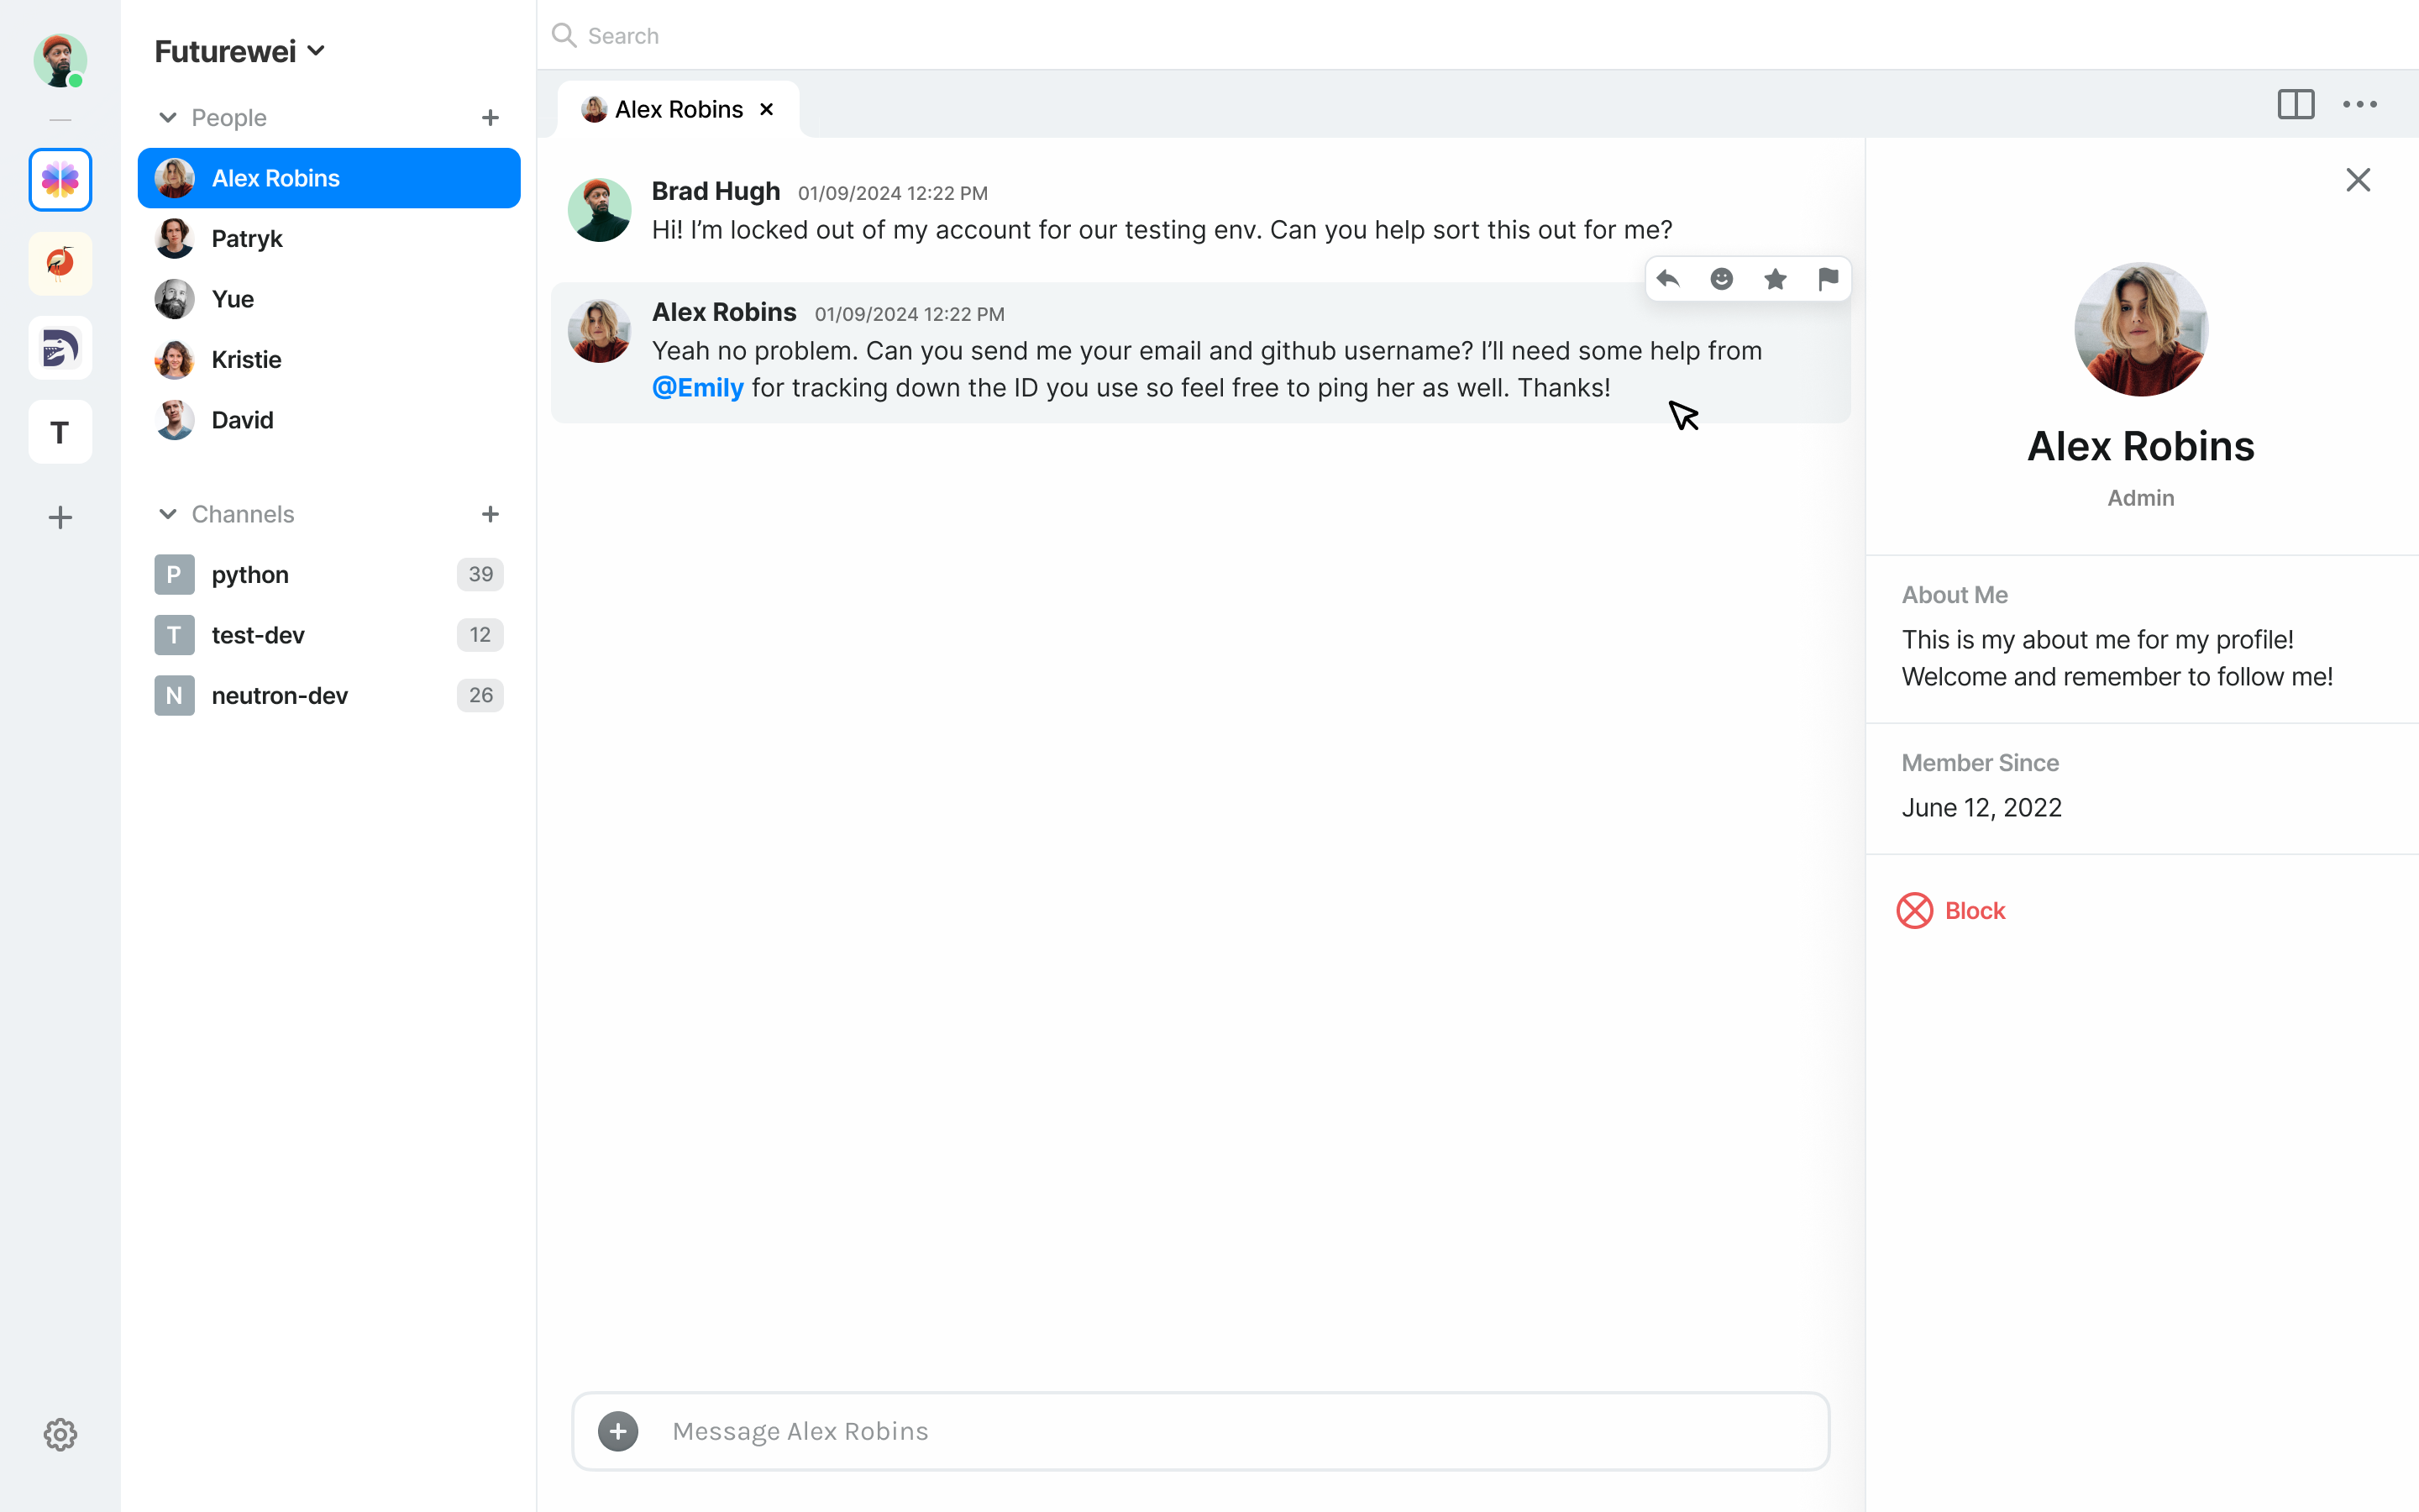
Proper UI/UX design

Slide 37
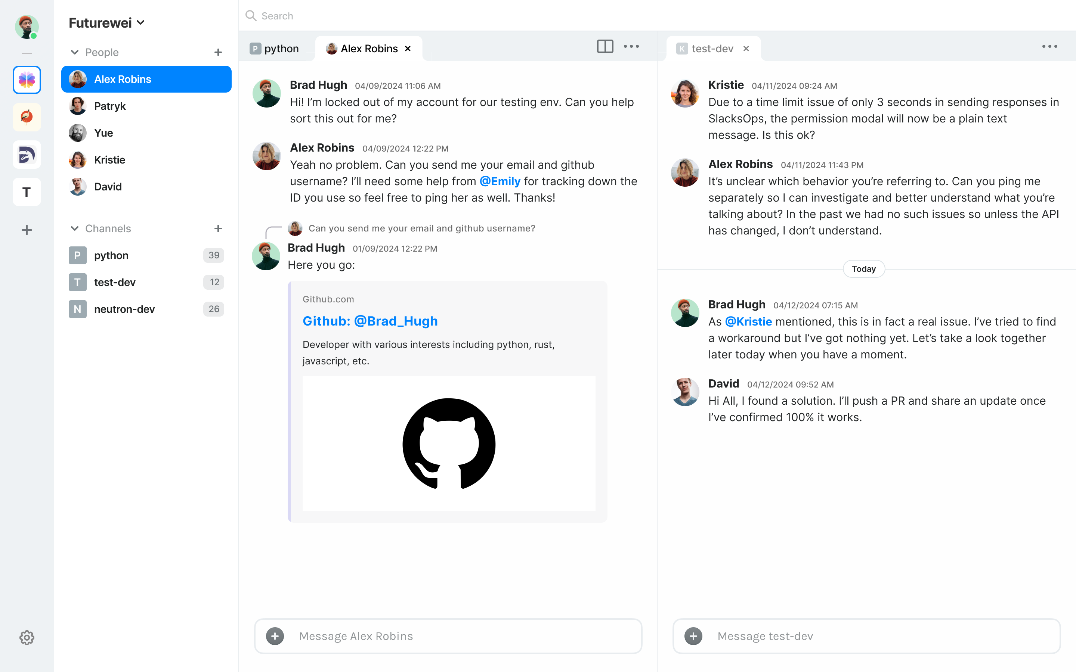
Multi-pane dockable tabs

Slide 39

AI features — local LLM integration via Moxin
Discord’s new chat topic summaries
Wouldn’t it be great to have these for Matrix chats?
But how can this work without giving an AI service access to all of your data?
Local LLMs — benefit from AI without jeopardizing E2EE, data sovereignty
“What’s happening”: AI-driven conversation summaries & topic analysis
“Action items”: AI identifies important messages & to-dos from a long backlog
Automated chatbots for handling public FAQs in an open-source project community
Longer-term: share LLM agents’ recipes and bot demos via Matrix
Currently not offered by existing tools like ChatGPT
Notes:
Future integration with Moxin, another Project Robius app being developed: “The Moxin App also integrates with the social community. It now supports an open-source model database/model card. The community can help improve the model card and add and validate more models. Also, we plan to fully integrate with the federated Matrix ecosystem so people can share the agents' recipes and demo their little bots, which ChatGPT or other tools do not provide as of today."

Slide 40
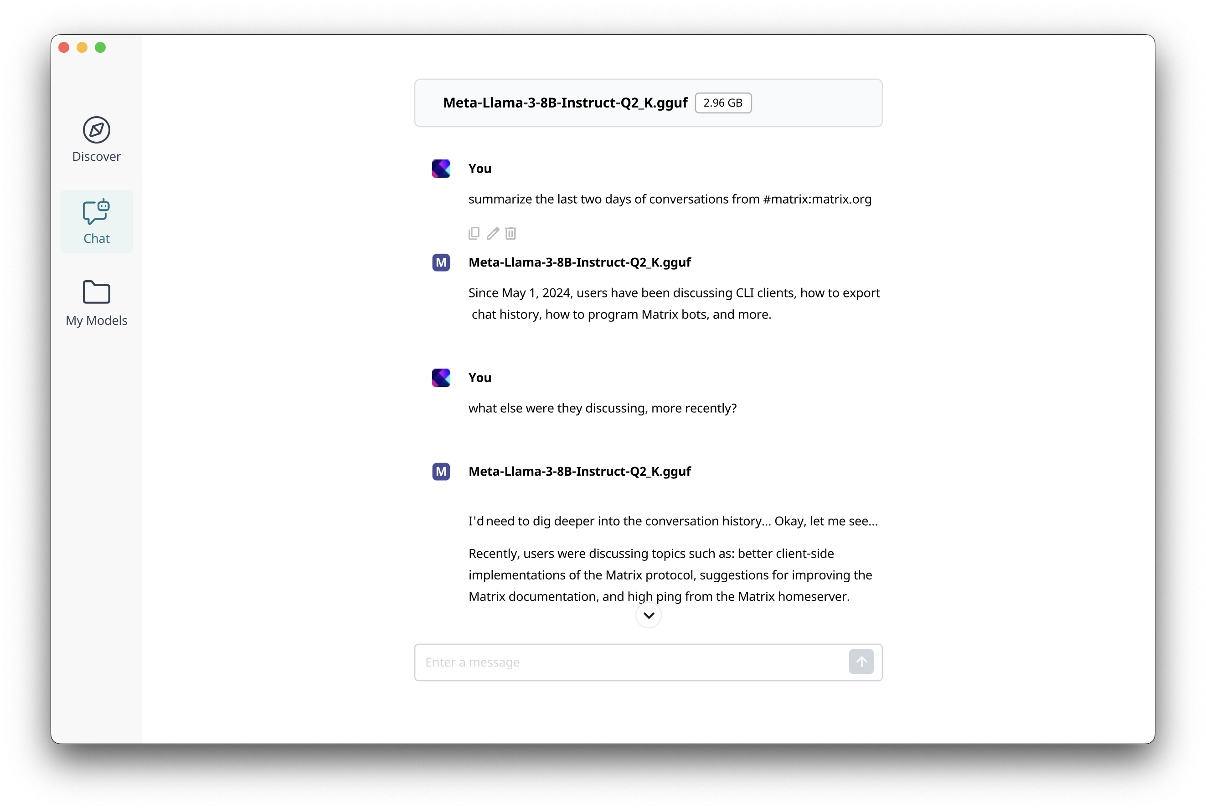
Robrix in-app AI chat
AI Chat

Slide 41
AI Chat
AI model is user’s choice

Slide 42
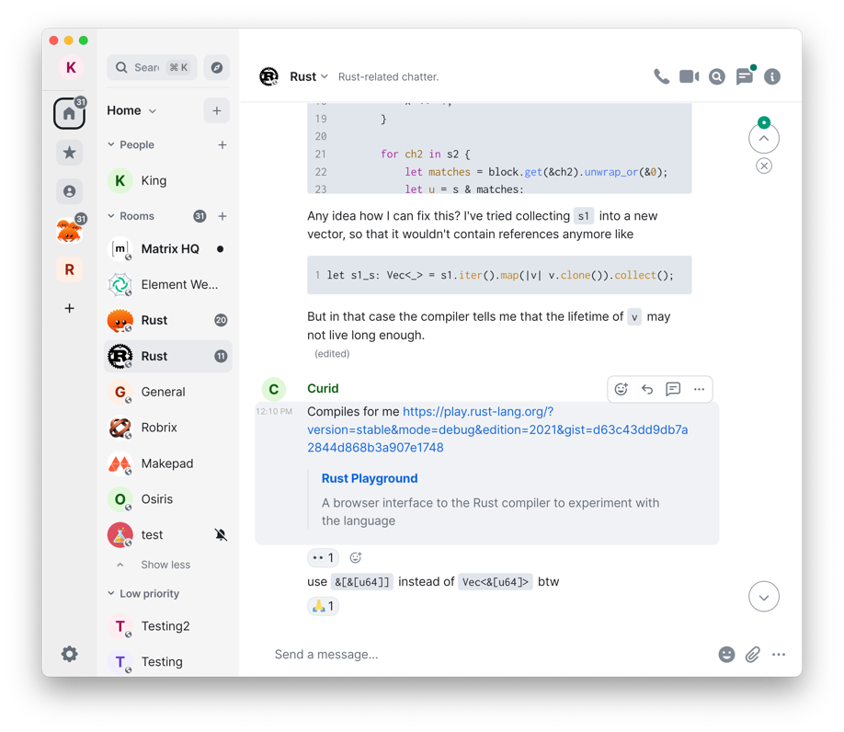
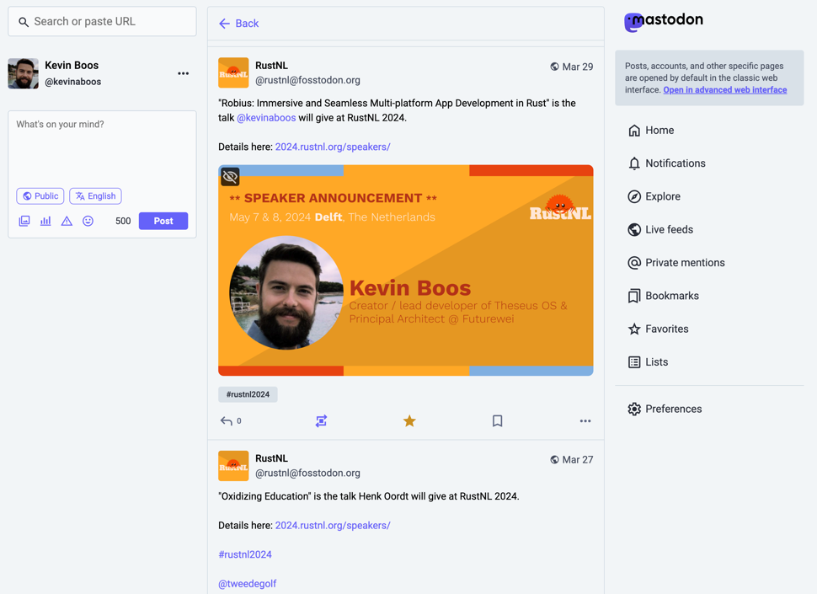
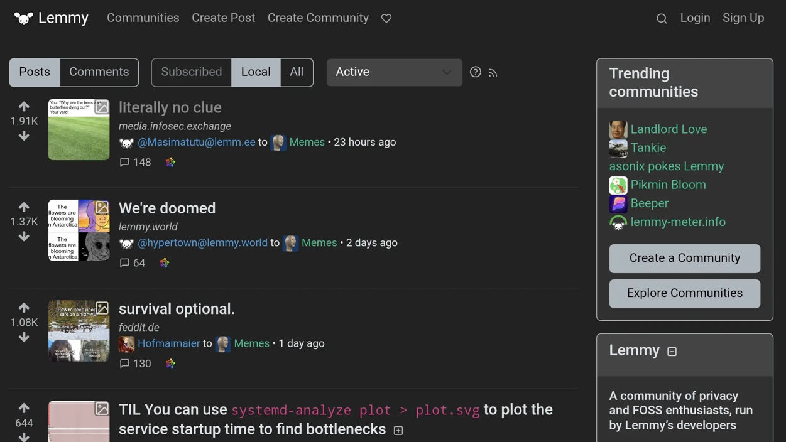
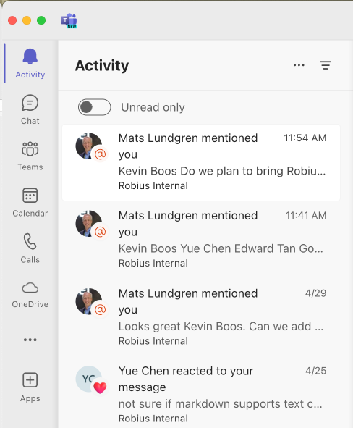
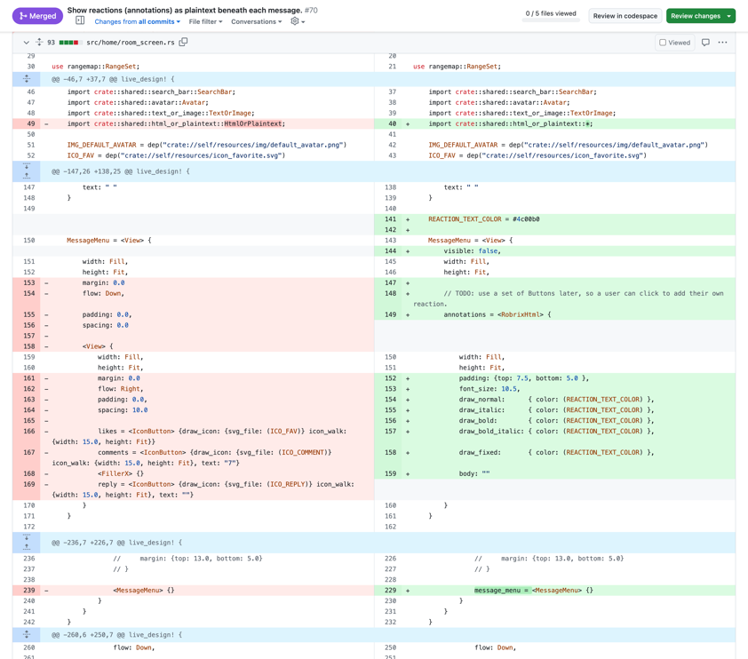
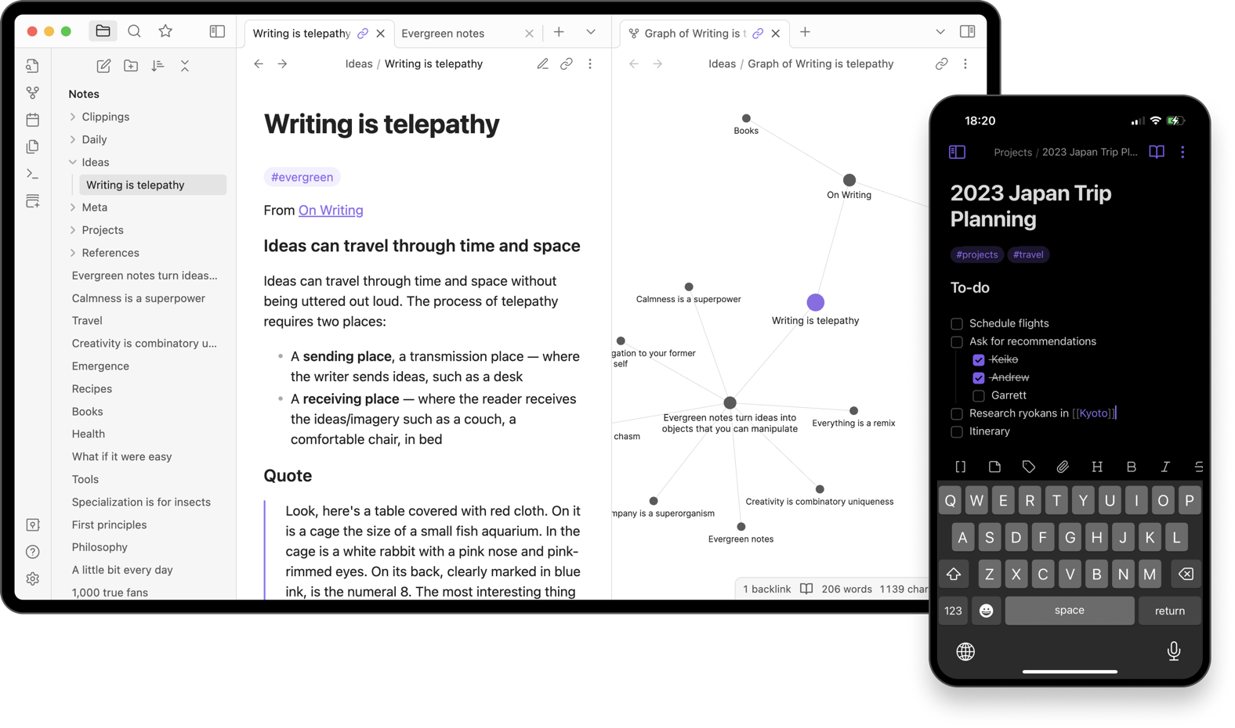
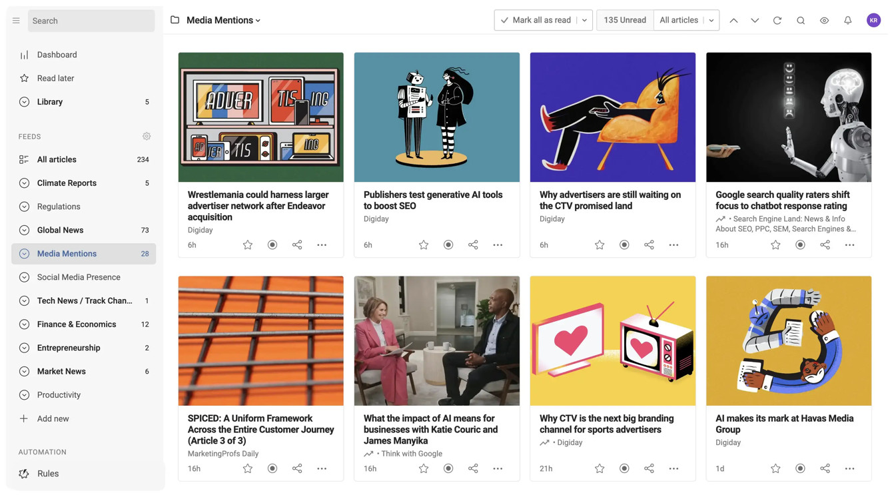
Stage 3 — a community hub (for open-source devs)
Chat (Matrix)
Microblogs (Mastodon)
Community Forums (Lemmy)
Notifications, activity pane
Code [re]view (git)
Notes
News feeds (RSS)
Notes:
Collect multiple services: ActivityPub (Mastodon, lemmy, code/reviews (github)
→ All the stuff the open-source community wants, all in one place
----------------
0. Data sovereignty (a user owns their data, can host & manage it, exposed via common federated standard APIs)
1. Place to host code (Gitlab, Github, etc)
2. Place to host chat (Matrix, etc)
3. Place for announcements, micro-blogs (Mastodon, twitter, etc)
4. Place to collect notifications across multiple services (Github updates/following, username tags on GH/matrix/mastodon/etc, replies/DMs on matrix & mastodon,
5. Place to collect discussion forums
6. Place to show news feeds (RSS feeds, etc)
----- Extras: -----
7. Place to host and view notes (Obsidian, Evernote, Google keep, etc)
Potential for novel "combo" features: easily publish tweets/toots on Mastodon and Matrix posts about a GitHub release for your project

Slide 43


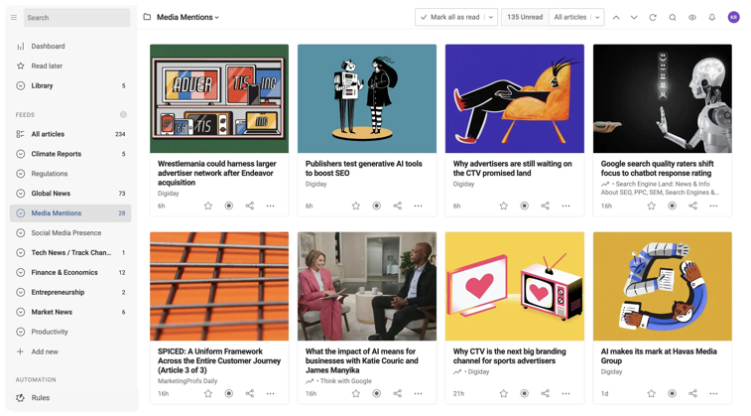

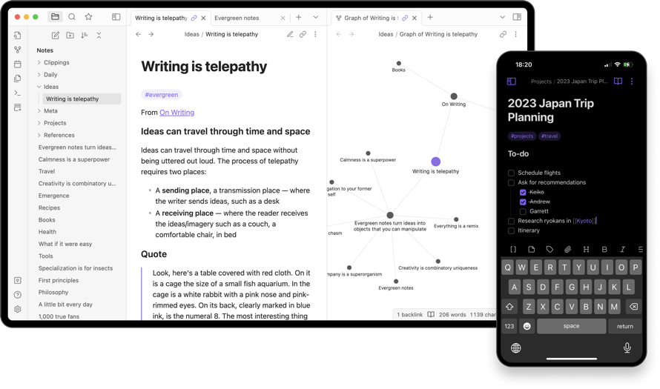
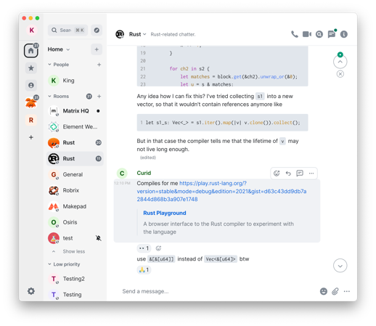

Collect multiple federated services in a single experience
robrix
Microblogs (Mastodon)
Community Forums (Lemmy)
News feeds (RSS)
Code [re]view (git)
Notes
Chat (Matrix)
Potential for powerful combo features & actions
Notes:
Collect multiple services: ActivityPub (Mastodon, lemmy, code/reviews (github)
Singular identity management via integration with Open Wallet Foundation
----------------
0. Data sovereignty (a user owns their data, can host & manage it, exposed via common federated standard APIs)
1. Place to host code (Gitlab, Github, etc)
2. Place to host chat (Matrix, etc)
3. Place for announcements, micro-blogs (Mastodon, twitter, etc)
4. Place to collect notifications across multiple services (Github updates/following, username tags on GH/matrix/mastodon/etc, replies/DMs on matrix & mastodon,
5. Place to collect discussion forums
6. Place to show news feeds (RSS feeds, etc)
----- Extras: -----
7. Place to host and view notes (Obsidian, Evernote, Google keep, etc)
8. micropayments as a financial "like" (kudos) that can be given for microblogs, release announcements, etc
Key feature: use an OpenWallet single sign-on for all of those services
Potential for novel "combo" features: easily publish tweets/toots on Mastodon and Matrix posts about a GitHub release for your project (then collect financial kudos on any of the three -- see below)

Slide 44

Identity mgmt. via OpenWallet
robrix
Single identity provider
$$
Send financial “kudos” (micropayments)
Notes:
Singular identity management via integration with Open Wallet Foundation
Robrix can act as a bridge to streamline identity management across many different services
Another interesting idea is supporting micropayments as a type of financial "like" (kudos).
This is common in WeChat (and recently, Youtube too), where users or community members can “super like” a microblog, release announcements, etc
And basically buy the creator a cup of coffee or something small to show their support.
Potential for novel "combo" features: easily publish tweets/toots on Mastodon and Matrix posts about a GitHub release for your project (then collect financial kudos on any of the three -- see below)

Slide 45
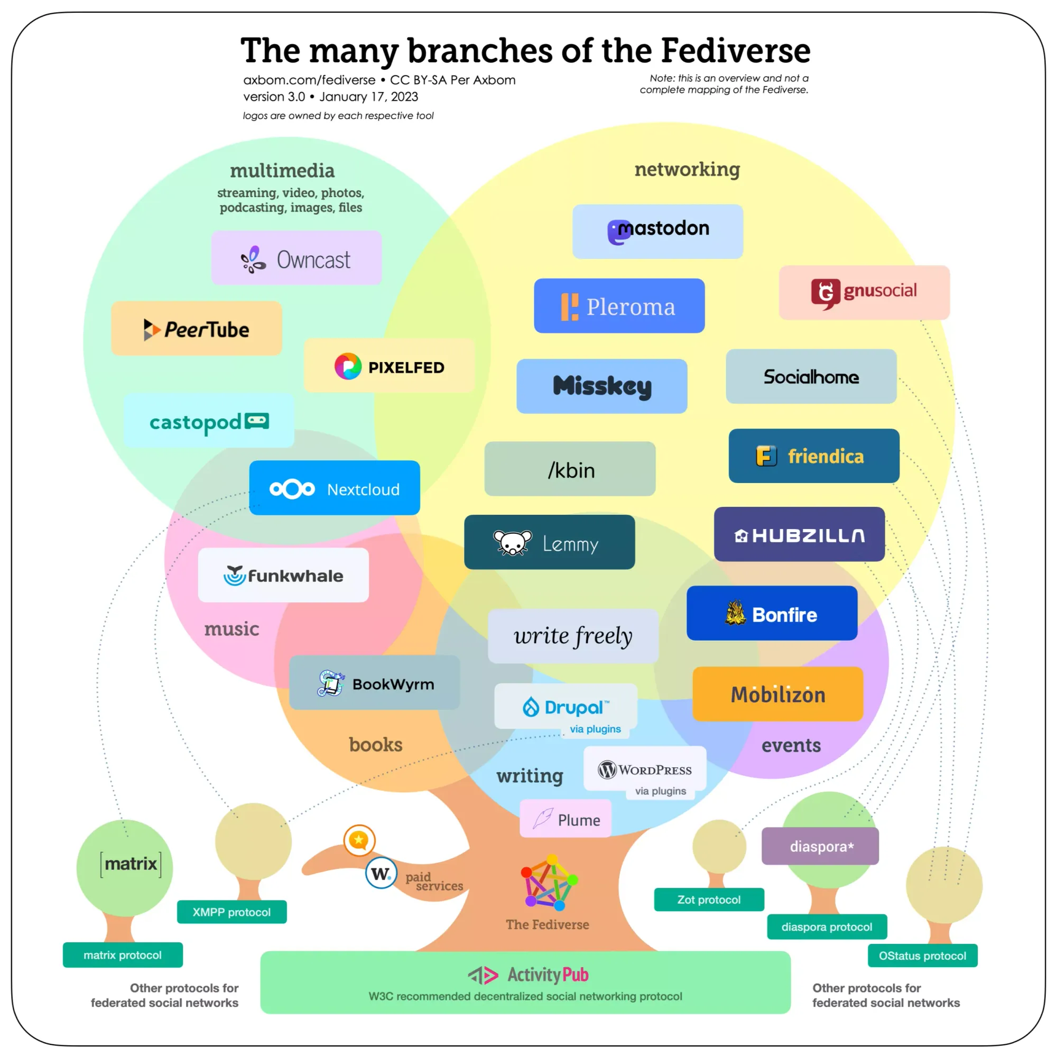
Many other service categories exist
Most based on ActivityPub
Image sharing | Pixelfed
Music sharing | Funkwhale
Podcasting | Castopod
Video hosting | PeerTube
Full blogging | Wordpress, Plume, etc.

Slide 46
make it easier to use and discover the fediverse
46
Notes:
We hope that with these additions, Robrix will make it easier and more inviting to use and discover the vast array of federated services out there across the internet.

Slide 47








Acknowledgments
Rik Arends
Eddy Bruël
Edward Tan
David Rheinsberg
Klim Tsoutsman
Sebastian Michailidis
Jorge Bejar
Julian Montes de Oca

Slide 48





ThanK YOU
Interested? Please reach out:
@project-robius/robrix
@kevinaboos
#robius@matrix.org

